Slide 1
Nehru Institute of Engineering and Technology
Department of Mechatronics Engineering
SUBJECT :MR3691 ROBOTICS
LECTURE 1
UNIT IV - ROBOT PROGRAMMING
TOPICS :INTRODUCTION- ROBOT PROGRAMMING
YEAR /SEMESTER :III /VI
PREPARED BY :Dr.SP.Arunkumar, Associate Professor

Slide 2
Classification of Robotics Languages
First Generation Language
Second Generation Language
World modelling and task oriented object level language

Slide 3
PROGRAMMING contd..
First Generation Language:
Off-Line Programming used in combination with teach pendant.
VAL is an example of this kind.

Slide 4
PROGRAMMING contd..
Second Generation Language:
AML,VAL II etc…
Structural Programming language performing complex tasks.
Apart from straight line interpolation performs complex motions.
Uses force, torque and other sensors.
Data processing, file management and keeping all records is done.

Slide 5
PROGRAMMING contd..
World modelling & task oriented object
level language:
More advanced language is WORLD modelling.
TIGHTEN THE NUT.
Intelligence is required.

Slide 6
PROGRAMMING contd..
In a robot, there are 3 basic modes of
operation:
Monitor mode
Edit mode
Run or Execute mode

Slide 7
PROGRAMMING contd..
Monitor mode:
Programmer define locations, load a particular information in a register, save transfer programs from storage.
Move back and forth into edit or run mode

Slide 8
PROGRAMMING contd..
Edit mode:
Programmer can edit or change set of instructions.
Run or Execute mode:
Pre defined task can be executed in run mode.
Dry run can be tested.
Debugging.

Slide 9
Motivation
– need to interface robot control system to external sensors, to provide “real time” changes based on sensory equipment
– computing based on geometry of environment
– ability to interface with CAD/CAM
– meaningful task descriptions
– off-line programming capability

Slide 10
Large number of robot languages available
AML, VAL, AL, RAIL, RobotStudio, etc. (200+)
Each robot manufacturer has their own robot programming language
No standards exist
Portability of programs virtually nonexistent

Slide 11
The VALTM Language
The VAL language was developed for PUMA robot
Monitor command are set of administrative instructions that direct the operation of the robot system.
Some of the functions of Monitor commands are Preparing the system for the user to write programs for PUMA Defining points in space
Commanding the PUMA to execute a program
Listing program on the CRT
Examples for monitor commands are: EDIT, EXECUTE, SPEED, HERE etc.

Slide 12
○ MCL stands for Machine Control Language developed by Douglas. The language is based on the APT and NC language. Designed control complete manufacturing cell. MCL is enhancement of APT which possesses additional options and features needed to do off-line programming of robotic work cell. Additional vocabulary words were developed to provide the supplementary capabilities intended to be covered by the MCL. These capability include Vision, Inspection and Control of signals

Slide 13
MCL also permits the user to define MACROS like statement that would be convenient to use for specialized applications. MCL program is needed to compile to produce CLFILE. Some commands of MCL programming languages are DEVICE, SEND, RECEIV, WORKPT, ABORT, TASK, REGION, LOCATE etc.

Slide 14
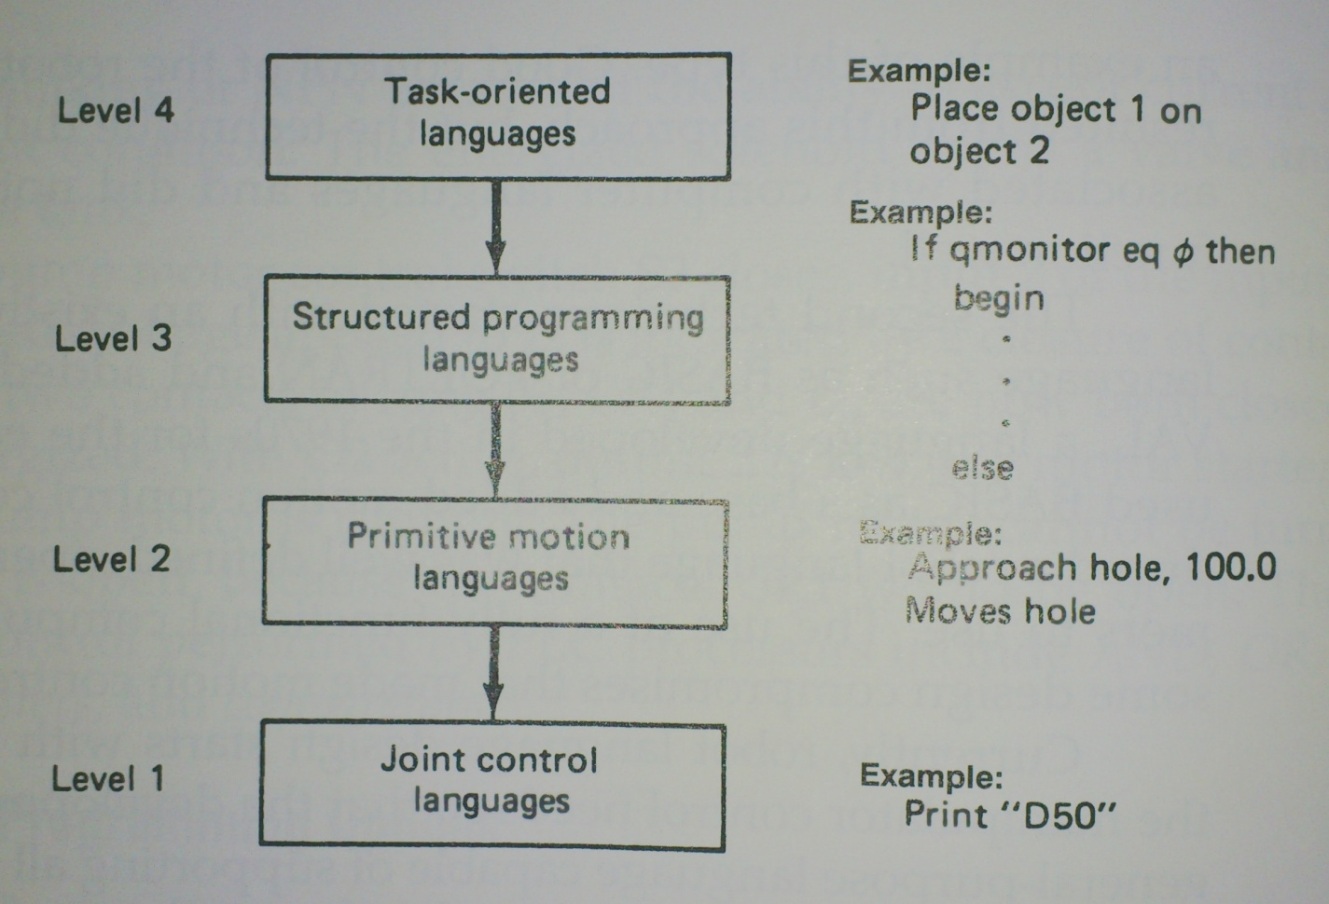
2.4 Robot Programming
Programming Language Levels

Slide 15
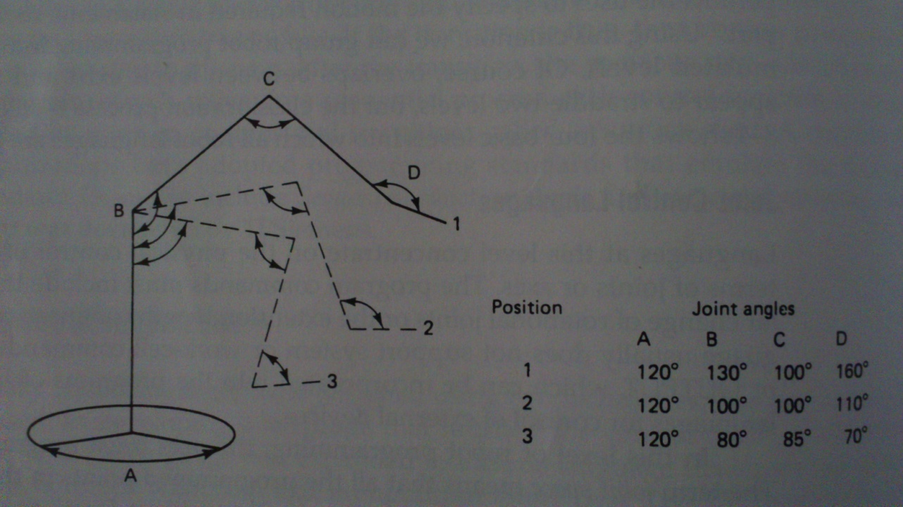
2.4 Robot Programming
Level 1 - Joint-Control Languages
Concentrate on the physical control of robot motion in terms of joint or axes.
This level is used on most stop-to-stop pneumatic robots controlled with PLC.

Slide 16
2.4 Robot Programming
Level 2 - Primitive Motion Languages
Point-to-point languages
Permit simple parallel using two or more arms in the same work space
Some languages have limited coordinate-transformation capabilities.
Advantage: Proven performance on the the manufacturing floor
Disadvantages: The emphasis in programming is still on robot motion rather than on the production problem. This level does not support off-line programming.

Slide 17
2.4 Robot Programming
Level 3 - Structured Programming Languages
Improvement over the primitive motion level.
The characteristics;
A structured control format
Extensive use of coordinate transformations and reference frames is permitted
Support complex data structures
Improved sensor command
System variables are permitted
The format encourages extensive use of branching and subroutines defines by the user
Communication capability with LAN is improved
Off-line programming is supported.

Slide 18
2.4 Robot Programming
Level 4 – Task- Oriented Languages
The primary function is to conceal from the user the command and program structure that normally written by the programmer.
The user must be concerned only with solving the manufacturing problem.
This languages significantly use in industrial research laboratories and university.

Slide 19
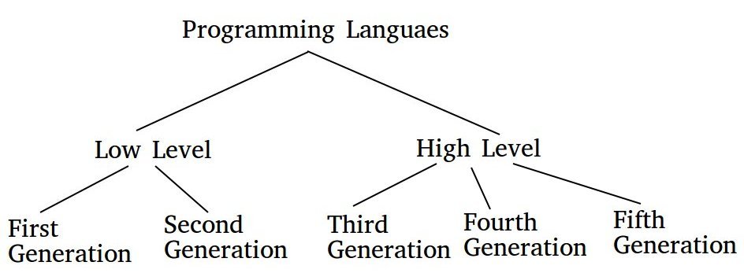

Slide 20
Fourth Generation Languages :
These are languages that consist of statements that are similar to statements in the human language. These are used mainly in database programming and scripting. Example of these languages include Perl, Python, Ruby, SQL,MatLab(MatrixLaboratory).
Fifth Generation Languages :
These are the programming languages that have visual tools to develop a program. Examples of fifth generation language include Mercury, OPS5, and Prolog.
The first two generations are called low level languages. The next three generations are called high level languages.

